Slide 2
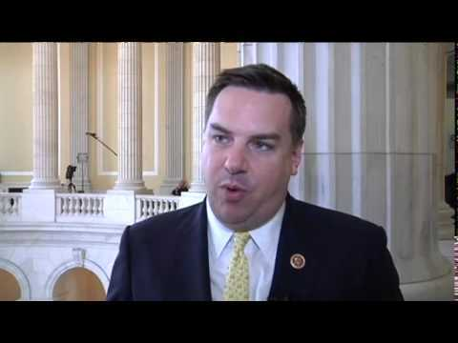
How did they vote in 2015?
Rep. Renee Ellmers (R-NC2) Rep. Richard Hudson (R-NC8)

Slide 3
Abortion & Abortion Laws
HR 7 - No Taxpayer Funding for Abortion and Abortion Insurance Full Disclosure Act of 2015 – PASSED HOUSE
Vote to pass a bill that prohibits federal funding of any abortion services and of health benefits coverage that provides any abortion services.
Ellmers – Co-sponsor – Yea Hudson - Co-Sponsor - Yea

Slide 4
Abortion & Abortion Laws
HR36 -Pain-Capable Unborn Child Protection Act – PASSED HOUSE
prohibits a physician from performing an abortion on a woman after 20 weeks of pregnancy, except in certain cases of medical emergency, rape, or incest.
Ellmers – Yea Hudson –Co-Sponsor - Yea
HR 3504 - Born-Alive Abortion Survivors Protection Act – PASSED HOUSE
amends requirements relating to infants born alive during an abortion.
Ellmers – Yea Hudson – Co-Sponsor - Yea
HR 3495 - Women's Public Health and Safety Act – PASSED HOUSE
authorizes states to determine if an abortion provider qualifies for Medicaid programs.
Ellmers – Yea Hudson – Co-Sponsor – Did Not Vote
HR 3134 - Defund Planned Parenthood Act of 2015 – PASSED HOUSE
rescinds funds for Planned Parenthood.
Ellmers – Yea Hudson – Co-Sponsor - Yea

Slide 5
Firearms
HR 822 - Requiring State Reciprocity for Carrying Concealed Firearms – PASSED HOUSE
requires states to recognize permits issued by another state that authorize the concealed carry of a firearm.
Ellmers – Yea Hudson - Yea
H Amdt 1098 - Prohibits District of Columbia from Implementing Certain Firearm Laws – AMENDMENT ADOPTED
prohibits the government of the District of Columbia from using funds appropriated by this bill to enforce certain firearms statutes.
Ellmers – Yea Hudson – No Vote

Slide 6
Health and Healthcare
HR 3762 - Restoring Americans' Healthcare Freedom Reconciliation Act of 2015 PASSED HOUSE, VETOED, VETO OVERRIDE FAILED
override a veto of a bill that repeals certain provisions of the Affordable Care Act and rescinds funds from abortion providers.
Ellmers – Yea Hudson - Yea
HR 596 - Repeal of the Patient Protection and Affordable Care Act and Health Care-Related Provisions in the Health Care and Education Reconciliation Act of 2010 – PASSED HOUSE
repeals the Patient Protection and Affordable Care Act (PPACA) and reestablishes provisions of law amended or repealed by the PPACA, effective 180 days after the enactment of this bill.
Ellmers – Yea Hudson - Yea
HR 3495 - Women's Public Health and Safety Act – PASSED HOUSE
authorizes states to determine if an abortion provider qualifies for Medicaid programs.
Ellmers – Yea Hudson – Co-Sponsor – Did Not Vote

Slide 7
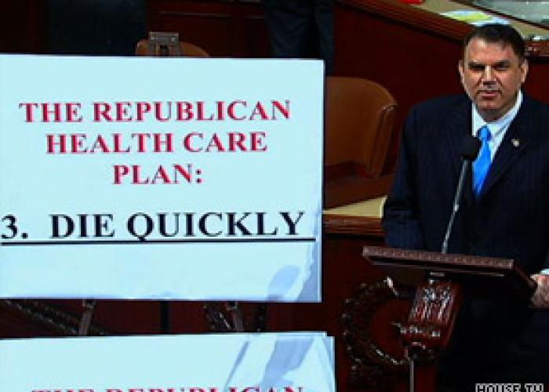

Slide 8
National Security
HR 240 - Department of Homeland Security Appropriations Act of 2015 – PASSED HOUSE
appropriates funds for the Department of Homeland Security for the fiscal year ending September 30, 2015.
Ellmers – Nay Hudson - Yea
HR 4038 - American Security Against Foreign Enemies (SAFE) Act – PASSED HOUSE
expands background checks for Syrian and Iraqi refugees applying for admission to the United States.
Ellmers – Yea Hudson – Co-Sponsor - Yea

Slide 9
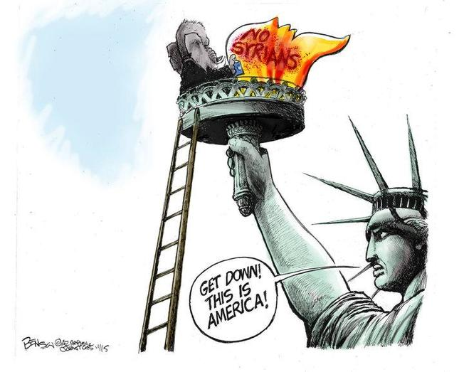

Slide 10
Oil & Gas
HR 3 Keystone XL Pipeline Act – PASSED HOUSE
authorizes the construction, operation, and maintenance of the Keystone XL Pipeline project.
Ellmers – Co-Sponsor - Yea
Hudson – Co-Sponsor - Yea
HR 702 To Adapt to Changing Crude Oil Market Conditions – PASSED HOUSE
authorizes the export of crude oil.
Ellmers – Yea
Hudson – Did Not Vote

Slide 11
HR 1105 - Death Tax Repeal Act of 2015 – PASSED HOUSE
repeals the estate tax and the generation-skipping transfer tax, effective on the date of enactment of this bill.
Ellmers – Yea Hudson – Co-Sponsor - Yea
HR 2029 - Consolidated Appropriations Act, 2016 – PASSED HOUSE
Mixed bag; little bit of everything. Export crude oil; Visa waver program for Syrian, etc. immigrants; repeal medical device tax; extend child tax credit and American Opportunity tax credit; increase EITC; etc., etc.
Ellmers – Yea Hudson – Nay (after Senate amendments)

Slide 12
Jobs
ARE YOU KIDDING?!
ZERO JOBS BILLS

Slide 13
For more information, visit:
https://votesmart.org/candidate/key-votes/120897/renee-ellmers#.Vreo_VgrLIU
http://votesmart.org/candidate/key-votes/136448/richard-hudson#.VrepH1grLIU
www.votesmart.org

